Slide 1

Terraform
info@zekeLabs.com | www.zekeLabs.com | +91 8095465880

Slide 2
Why Terraform?
Readability
Interoperability
Parallel processing
Reusability
Flexibility
Open source
Availability of templates
info@zekeLabs.com | www.zekeLabs.com | +91 8095465880

Slide 3
Features of Terraform
Infrastructure as code
Execution Plan
Resource Graph
Automatic ordering
Configuration management
Supports HCL and JSON
info@zekeLabs.com | www.zekeLabs.com | +91 8095465880

Slide 4
Features of Terraform
Simple model of resource entities with attributes
Stateful lifecycle with CRUD operations
Declarative configuration
Dependencies by inference
Parallel execution
info@zekeLabs.com | www.zekeLabs.com | +91 8095465880

Slide 5
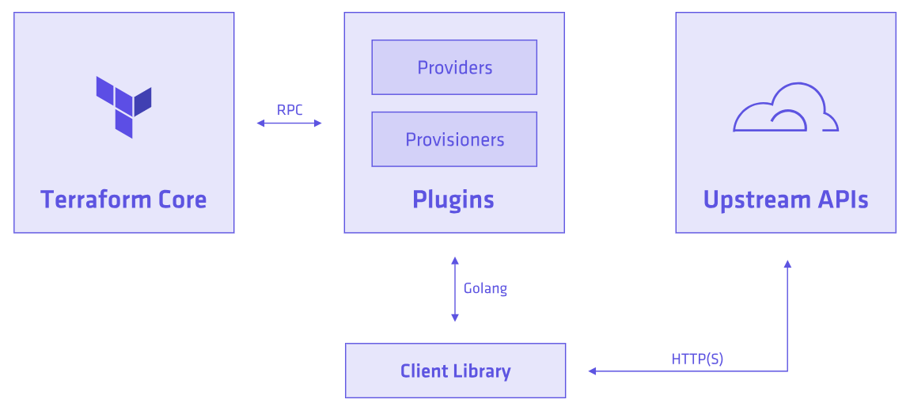
Architecture of Terraform
info@zekeLabs.com | www.zekeLabs.com | +91 8095465880

Slide 6
Terraform Lab Setup
info@zekeLabs.com | www.zekeLabs.com | +91 8095465880

Slide 7
Terraform WorkFlow
Write - Author infrastructure as code.
Plan - Preview changes before applying.
Apply - Provision reproducible infrastructure.
info@zekeLabs.com | www.zekeLabs.com | +91 8095465880

Slide 8
Configuration
Terraform format ends in :
.tf
.tf.json
Multiple file formats can be present in the same directory.
info@zekeLabs.com | www.zekeLabs.com | +91 8095465880

Slide 9
Core concepts in terraform configuration
Providers: A source of resources. [With an API endpoint and authentication. E.g AWS]
Resource: Everything that has a set of configurable attributes and a lifecycle such as create, read, update, delete. [aws ec2 instance] -- impies id and state
Data sources : information read from providers. E.g. lookup from own AWS account for ami_id or keypairs.
Provisioner: initialize a resource from a local or remote script.
info@zekeLabs.com | www.zekeLabs.com | +91 8095465880

Slide 10
Resources
Basic building block of terraform scripts.
Terraform is used to create, manage, and update infrastructure resources such as physical machines, VMs, network switches, containers, and more.
Almost any infrastructure type can be represented as a resource in Terraform.
Resources undergo CRUD operation.
info@zekeLabs.com | www.zekeLabs.com | +91 8095465880

Slide 11
Providers
A provider is responsible for understanding API interactions and exposing resources.
Providers generally are :
IaaS (e.g. AWS, GCP, Microsoft Azure, OpenStack),
PaaS (e.g. Heroku),
SaaS services (e.g. Terraform Enterprise, DNSimple, CloudFlare).
Providers define resources.
info@zekeLabs.com | www.zekeLabs.com | +91 8095465880

Slide 12
Provisioners
Provisioners are added directly to any resource:
Used to :
execute scripts on a local or remote machine as part of resource creation or destruction.
Used to bootstrap a resource,
cleanup before destroy,
run configuration management, etc.
Example:
chef
file
habitat
Local-exec and remote-exec
null_resource
info@zekeLabs.com | www.zekeLabs.com | +91 8095465880

Slide 13
Terraform Commands
$ terraform init
$ terraform validate
$ terraform plan -out=my.plan
$ terraform show my.plan
$ terraform apply my.plan
info@zekeLabs.com | www.zekeLabs.com | +91 8095465880

Slide 14
More Terraform Commands
$ terraform output
$ terraform output -json
$ terraform plan -destroy
$ terraform destroy
info@zekeLabs.com | www.zekeLabs.com | +91 8095465880

Slide 15
Terraform init
Provider initialization is one of the actions of terraform init.
Running this command will download and initialize any providers that are not already initialized.
Initialization downloads and installs the provider's plugin and prepares it to be used.
info@zekeLabs.com | www.zekeLabs.com | +91 8095465880

Slide 16
Lab: Terraform Commands
info@zekeLabs.com | www.zekeLabs.com | +91 8095465880

Slide 17
Variable type
String
Map
List
boolean
info@zekeLabs.com | www.zekeLabs.com | +91 8095465880

Slide 18
Interpolation
Allows to reference variables, attributes of resources, call functions.
Wrapped in ${foo}
Can be disabled with $${foo}
info@zekeLabs.com | www.zekeLabs.com | +91 8095465880

Slide 19
Variable types: string
variable “instance_name” {
type = “string”
default = “zekeAWSinstance”
}
var.instance_name
interpolation: ${var.instance_name}
info@zekeLabs.com | www.zekeLabs.com | +91 8095465880

Slide 20
Variables types : map
var.MAP["KEY"]
Example: inside terraform.tfvars file:
amis = { "us-east-1" = "ami-abc123" "us-west-2" = "ami-def456" }
Interpolation: ${var.amis["us-east-1"]}
info@zekeLabs.com | www.zekeLabs.com | +91 8095465880

Slide 21
Variables types : list
In terraform.tfvars:
subnets = [“ap-south-1a-public”, “ap-south-1a-private”]
${var.LIST}
interpolation: ${var.subnets}
interpolation: ${var.subnets[idx]}
info@zekeLabs.com | www.zekeLabs.com | +91 8095465880

Slide 22
LAB: join-and-count
info@zekeLabs.com | www.zekeLabs.com | +91 8095465880

Slide 23
Attributes of your own resource
self.ATTRIBUTE
interpolation: ${self.private_ip}
info@zekeLabs.com | www.zekeLabs.com | +91 8095465880

Slide 24
Attributes of other resources
TYPE.NAME.ATTRIBUTE
interpolation: ${aws_instance.web.id}
info@zekeLabs.com | www.zekeLabs.com | +91 8095465880

Slide 25
Attributes of a data source
data.TYPE.NAME.ATTRIBUTE
interpolation: ${data.aws_subnet.subnet.cidr_block}
interpolation: ${data.aws_subnet.subnet.0.cidr_block} #if count enabled, get value at index 0
interpolation: ${data.aws_subnet.example.*.cidr_block} #get all attributes
info@zekeLabs.com | www.zekeLabs.com | +91 8095465880

Slide 26
Outputs from a module
Module.name.output
interpolation: ${module.container.id}
info@zekeLabs.com | www.zekeLabs.com | +91 8095465880

Slide 27
Count
count.FIELD
interpolation: ${count.index}
info@zekeLabs.com | www.zekeLabs.com | +91 8095465880

Slide 28
State
Terraform state is the state about managed infrastructure and configuration.
This state is used to map real world resources in configuration, keep track of metadata, and to improve performance for large infrastructures.
This state is stored by default in a local file name “terraform.tfstate”, in JSON syntax.
State file can be stored remotely, to be used in a team environment.
local state is used by Terraform to create plans and make changes in the infrastructure.
CLI command “terraform state” shall be used to work with state.
info@zekeLabs.com | www.zekeLabs.com | +91 8095465880

Slide 29
State
Terraform.tfstate file is extremely important; it keeps track of the IDs of created resources so that Terraform knows what it is managing.
This file must be saved and distributed to anyone who might run Terraform.
It is recommended to setup remote state when working with Terraform, to share the state automatically,
info@zekeLabs.com | www.zekeLabs.com | +91 8095465880

Slide 30
State
$ terraform show
aws_instance.example:
id = i-32cf65a8
ami = ami-2757f631
availability_zone = us-east-1a
instance_state = running
instance_type = t2.micro
private_ip = 172.31.30.244
public_dns = ec2-52-90-212-55.compute-1.amazonaws.com
public_ip = 52.90.212.55
subnet_id = subnet-1497024d
vpc_security_group_ids.# = 1
vpc_security_group_ids.3348721628 = sg-67652003
info@zekeLabs.com | www.zekeLabs.com | +91 8095465880

Slide 31
Lab: Docker containers
info@zekeLabs.com | www.zekeLabs.com | +91 8095465880

Slide 32
Provider version
>= 1.2.0: version 1.2.0 or newer
<= 1.2.0: version 1.2.0 or older
~> 1.2.0: any non-beta version >= 1.2.0 and < 1.3.0, e.g. 1.2.X
~> 1.2: any non-beta version >= 1.2.0 and < 2.0.0, e.g. 1.X.Y
>= 1.0.0, <= 2.0.0: any version between 1.0.0 and 2.0.0 inclusive
To upgrade to the latest acceptable version of each provider, run terraform init -upgrade .
info@zekeLabs.com | www.zekeLabs.com | +91 8095465880

Slide 33
Provider alias
# The default provider configuration
provider "aws" {
# ...
}
# Additional provider configuration for west coast region
provider "aws" {
alias = "west"
region = "us-west-2"
}
# use in configuration
resource "aws_instance" "foo" {
provider = "aws.west"
# ...
}
info@zekeLabs.com | www.zekeLabs.com | +91 8095465880

Slide 34
Variable
Variable block configures a single input variable for a Terraform module.
Each block declares a single variable.
variable "images" {
type = "map"
default = {
us-east-1 = "image-1234"
us-west-2 = "image-4567"
}
Description = “image id to be used for an instance”
}
info@zekeLabs.com | www.zekeLabs.com | +91 8095465880

Slide 35
Local values
Local values assign a name to an expression, that can then be used multiple times within a module.
Syntax : check files
info@zekeLabs.com | www.zekeLabs.com | +91 8095465880

Slide 36
Components of Variable
Type (optional) # nature of variable
Default (optional) # default value if it is not provided in configuration
Description (Optional) # For documentation purposes
info@zekeLabs.com | www.zekeLabs.com | +91 8095465880

Slide 37
Environment Variable
For a variable like this:
variable "somelist" { type = "list" }
Set environment variable using command:
$ TF_VAR_somelist='["ami-abc123", "ami-bcd234"]' terraform plan
info@zekeLabs.com | www.zekeLabs.com | +91 8095465880

Slide 38
Variable files
Write normal syntax in a file: foo.tfvars
foo = "bar" xyz = "abc" somelist = [ "one", "two", ]
$ terraform apply -var-file=foo.tfvars
info@zekeLabs.com | www.zekeLabs.com | +91 8095465880

Slide 39
Example: Using Variable for AWS providers
variable "access_key" {}
variable "secret_key" {}
variable "region" {
default = "us-east-1"
}
provider "aws" {
access_key = "${var.access_key}"
secret_key = "${var.secret_key}"
region = "${var.region}"
}
info@zekeLabs.com | www.zekeLabs.com | +91 8095465880

Slide 40
Variable through CLI
$ terraform apply -var 'foo={quux="bar"}' -var 'foo={bar="baz"}'
$ terraform apply -var 'access_key=foo' -var 'secret_key=bar'
$ terraform apply -var-file="secret.tfvars" -var-file="production.tfvars"
info@zekeLabs.com | www.zekeLabs.com | +91 8095465880

Slide 41
Variable precedence
Definition files passed using the -var-file flag will be evaluated after those in the working directory.
Values passed within definition files or with -var will take precedence over TF_VAR_ environment variables, as environment variables are considered defaults.
If more than one definition files (using -var-file flags) are supplied the rightmost shall take precedence (as it is loaded in the last)
info@zekeLabs.com | www.zekeLabs.com | +91 8095465880

Slide 42
Lab: variables and tfvars
info@zekeLabs.com | www.zekeLabs.com | +91 8095465880

Slide 43
output
Shows values that are highlighted after terraform applies.
Can be seen by running command: terraform output
Maintained in terraform state
output "ami_id" { value = "${aws_instance.web.ami_id}" }
info@zekeLabs.com | www.zekeLabs.com | +91 8095465880

Slide 44
Components of output
Multiple output variables can be configured with multiple output blocks.
Parameter:
Value (string, list, map)
Description
Depends_on (list) # dependencies will be created before this output value is processed
Sensitive (boolean) # confidential, value is not revealed, can be seen by “terraform output”
info@zekeLabs.com | www.zekeLabs.com | +91 8095465880

Slide 45
backend
T
info@zekeLabs.com | www.zekeLabs.com | +91 8095465880

Slide 46
modules
Modules -
encapsulate groups of resources in your infrastructure.
are subdirectories with self-contained terraform code
may be sourced from Git, Mercurial, HTTPS locations
use variables and outputs to pass data
All attributes within the block must correspond to variables within the module, with exception of :
Source
Version
provider
info@zekeLabs.com | www.zekeLabs.com | +91 8095465880

Slide 47
LAB: template-and-file
info@zekeLabs.com | www.zekeLabs.com | +91 8095465880

Slide 48
Lab: conditionals
info@zekeLabs.com | www.zekeLabs.com | +91 8095465880

Slide 49
Lab: modules-from-monoliths
info@zekeLabs.com | www.zekeLabs.com | +91 8095465880

Slide 50
Lab: providing multiple environments using maps
info@zekeLabs.com | www.zekeLabs.com | +91 8095465880

Slide 51
Provisioners
Normally when bootstrapping servers create time provisioners let you
upload files,
run shell scripts, or
install and trigger configuration management tools etc.
Multiple Provisioners are possible in the same resource.
Destroy provisioners run just before destroying the resource. [use flag: when = "destroy"]
Destroy provisioners are useful especially in log collection.
Use on_failure = "continue" (or “fail”) if you want terraform apply to continue without error (or display error).
info@zekeLabs.com | www.zekeLabs.com | +91 8095465880

Slide 52
Provisioners : local exec
The local-exec provisioner invokes a local executable after a resource is created.
This invokes a process on the machine running Terraform, not on the resource.
Local executables could be a shell, powershell, python etc
info@zekeLabs.com | www.zekeLabs.com | +91 8095465880

Slide 53
Provisioners : local exec
resource "aws_instance" "zeke" {
ami = "ami-b374d5a5"
instance_type = "t2.micro"
...
provisioner "local-exec" {
command = "echo ${self.private_ip} > file.txt"
interpreter = ["PowerShell", "-Command"]
environment {
FOO = "bar"
BAR = 1
BAZ = "true"
}
}
}
info@zekeLabs.com | www.zekeLabs.com | +91 8095465880

Slide 54
Provisioners : file
The file provisioner is used to copy files or directories from the machine executing Terraform to the newly created resource.
Provide source and destination
info@zekeLabs.com | www.zekeLabs.com | +91 8095465880

Slide 55
Provisioners : file
resource "aws_instance" "web" {
# normal configuration
# Copies the myapp.conf file to /etc/myapp.conf
provisioner "file" {
source = "conf/myapp.conf"
destination = "/etc/myapp.conf"
}
}
info@zekeLabs.com | www.zekeLabs.com | +91 8095465880

Slide 56
Provisioners : remote exec
The remote-exec provisioner invokes a script on a remote resource after it is created.
This can be used to run a configuration management tool, bootstrap into a cluster, etc.
Arguments:
script
scripts
inline
info@zekeLabs.com | www.zekeLabs.com | +91 8095465880

Slide 57
Provisioners : remote exec
resource "aws_instance" "web" {
# ...
provisioner "remote-exec" {
inline = [
“yum install httpd -y”
"puppet apply",
"consul join ${aws_instance.web.private_ip}",
]
}
}
info@zekeLabs.com | www.zekeLabs.com | +91 8095465880

Slide 58
Provisioners : remote exec
resource "aws_instance" "web" {
# …
provisioner "file" {
source = "script.sh"
destination = "/tmp/script.sh"
}
provisioner "remote-exec" {
inline = [
"chmod +x /tmp/script.sh",
"/tmp/script.sh args",
]
}
info@zekeLabs.com | www.zekeLabs.com | +91 8095465880

Slide 59
Provisioners : null_resource
The null_resource is a resource that allows you to configure provisioners that are not directly associated with a single existing resource.
A null_resource behaves exactly like any other resource, so you configure provisioners, connection details, and other meta-parameters in the same way you would on any other resource.
info@zekeLabs.com | www.zekeLabs.com | +91 8095465880

Slide 60
Provisioners : null_resource
resource "null_resource" "datanode" {
count = "${var.count.datanode}"
triggers {
instance_ids = "${element(aws_instance.datanode.*.id, count.index)}"
}
}
info@zekeLabs.com | www.zekeLabs.com | +91 8095465880

Slide 61
Provisioners : chef
The chef provisioner installs, configures and runs the Chef Client on a remote resource.
The chef provisioner supports both ssh and winrm type connections.
The chef provisioner has some prerequisites for specific connection types:
For ssh type connections, cURL must be available on the remote host.
For winrm connections, PowerShell 2.0 must be available on the remote host.
info@zekeLabs.com | www.zekeLabs.com | +91 8095465880

Slide 62
Provisioners : chef
resource "aws_instance" "web" {
# ..
provisioner "chef" {
attributes_json =file(attr.json)
environment = "_default"
run_list = ["cookbook::recipe"]
node_name = "webserver1"
secret_key = "${file("../encrypted_data_bag_secret")}"
server_url = "https://chef.company.com/organizations/org1"
recreate_client = true
user_name = "bork"
user_key = "${file("../bork.pem")}"
version = "12.4.1"
# If you have a self signed cert on your chef server change this to :verify_none
ssl_verify_mode = ":verify_peer"
}
}
info@zekeLabs.com | www.zekeLabs.com | +91 8095465880

Slide 63
Miscellaneous
info@zekeLabs.com | www.zekeLabs.com | +91 8095465880

Slide 64
Terraform configuration
Used to configure Terraform itself,
Allows 2 attributes:
version
Backend
terraform { required_version = "> 0.7.0" }
info@zekeLabs.com | www.zekeLabs.com | +91 8095465880

Slide 65
Environment variables
TF_LOG #export TF_LOG=0
TF_LOG_PATH
TF_MODULE_PATH
TF_INPUT
TF_VAR_name
TF_CLI_ARGS and TF_CLI_ARGS_name
TF_DATA_DIR
TF_SKIP_REMOTE_TESTS
info@zekeLabs.com | www.zekeLabs.com | +91 8095465880

Slide 66
Remote state
With remote state, Terraform writes the state data to a remote data store, which can then be shared between all members of a team.
Terraform supports storing state in Terraform Enterprise, HashiCorp Consul, Amazon S3, and more.
Remote state is a feature of backends.
info@zekeLabs.com | www.zekeLabs.com | +91 8095465880

Slide 67
Remote backends
Remote backends allow Terraform to use a shared storage space for state data, so any member of a team can use Terraform to manage the same infrastructure.
Various remote backends are available, notably:
Consul for state storage, locking, and environments [Free and open source]
S3 which only supports state storage, for a low cost and minimally featured solution.
Terraform enterprise : commercial software from Hashicorp.
info@zekeLabs.com | www.zekeLabs.com | +91 8095465880

Slide 68
Why Remote backends
Working in a team
Keeping sensitive information off disk
Remote operations
info@zekeLabs.com | www.zekeLabs.com | +91 8095465880

Slide 69
How Remote backends
terraform {
backend "consul" {
address = "demo.consul.io"
scheme = "https"
path = "example_app/terraform_state"
}
}
info@zekeLabs.com | www.zekeLabs.com | +91 8095465880

Slide 70
Remote state
$ terraform remote config -backend=s3 \
-backend-config=”bucket=zeke_config_bucket” \
-backend-config=”key=zeke_folder/terraform.tfstate” \
-backend-config=”region=ap-south-1”
info@zekeLabs.com | www.zekeLabs.com | +91 8095465880

Slide 71
workspaces
Each Terraform configuration has an associated backend.
The persistent data stored in the backend belongs to a workspace.
Initially the backend has only one workspace, called "default", and thus there is only one Terraform state associated with that configuration with local backend.
Certain backends support multiple named workspaces, allowing multiple states to be associated with a single configuration.
Use command “terraform workspace”
info@zekeLabs.com | www.zekeLabs.com | +91 8095465880

Slide 72
Use remote state
data ”terraform_remote_state” ”vpc” {
backend = ”s3”
config {
bucket = ”zeke_config”
key = ”zeke_config_folder/terraform.tfstate”
region = ”eu-central-1”
}
}
resource ”aws_instance” ”foo” { # use state from vpc_project
subnet_id = ”${data.terraform_remote_state.vpc.subnet_id}”
}
info@zekeLabs.com | www.zekeLabs.com | +91 8095465880

Slide 73
Override Configuration
Normal loaded configuration files are appended to each other.
Override files merge , not append.
info@zekeLabs.com | www.zekeLabs.com | +91 8095465880

Slide 74
Terraform registry
info@zekeLabs.com | www.zekeLabs.com | +91 8095465880

Slide 75
Writing terraform script
info@zekeLabs.com | www.zekeLabs.com | +91 8095465880

Slide 76
depends_on
resource "aws_s3_bucket" "example" {
bucket = "zeke-terraform-bucket"
acl = "private"
}
resource "aws_instance" "example" {
ami = "ami-2757f631"
depends_on = ["aws_s3_bucket.example"]
}
info@zekeLabs.com | www.zekeLabs.com | +91 8095465880

Slide 77
filter
Example:
data "aws_ami" "ubuntu" { most_recent = true filter { name = "name" values = ["ubuntu/images/hvm-ssd/ubuntu-trusty-14.04-amd64-server-*"] } filter { name = "virtualization-type" values = ["hvm"] } owners = ["099720109477"] }
info@zekeLabs.com | www.zekeLabs.com | +91 8095465880

Slide 78
lifecycle
resource "aws_launch_configuration" "as_conf" { image_id = "${data.aws_ami.ubuntu.id}" instance_type = "m4.large" spot_price = "0.001" lifecycle { create_before_destroy = true } }
info@zekeLabs.com | www.zekeLabs.com | +91 8095465880

Slide 79
Trivia
If a resource does not depend on any other resource, it can be created in parallel with the other resources.
Where possible, Terraform will perform operations concurrently to reduce the total time taken to apply changes.
info@zekeLabs.com | www.zekeLabs.com | +91 8095465880

Slide 80
Best practices : resources
Avoid inline blocks: To make the code more modular and reusable. resource "aws_route_table" "example" { vpc_id = "${aws_vpc.example.id}"
route {
cidr_block = "10.0.1.0/24"
gateway_id = "${aws_internet_gateway.example.id}"
}
}
Use Separate block instead resource "aws_route_table" "example" { vpc_id = "${aws_vpc.example.id}" }
resource "aws_route" "example" {
route_table_id = "${aws_route_table.example.id}"
destination_cidr_block = "10.0.1.0/24"
gateway_id = "${aws_internet_gateway.example.id}"
}
info@zekeLabs.com | www.zekeLabs.com | +91 8095465880

Slide 81
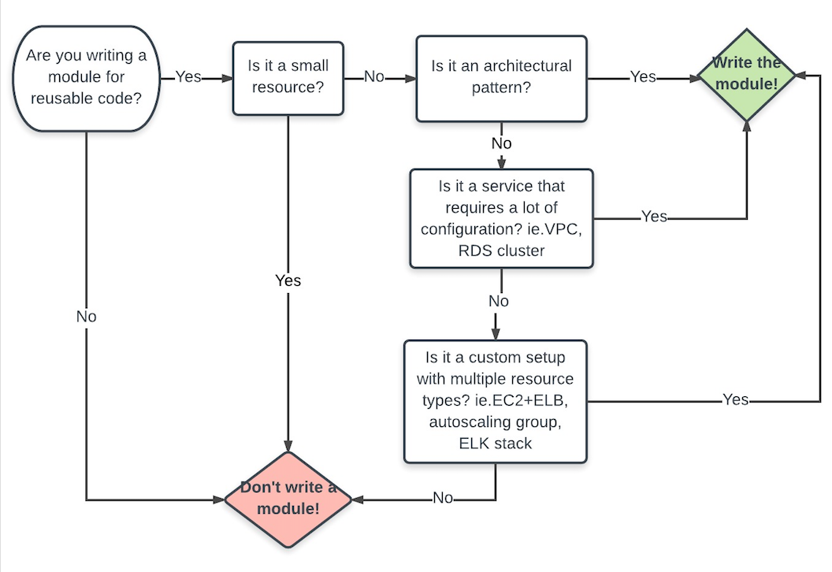
Best practices : writing a module ?
info@zekeLabs.com | www.zekeLabs.com | +91 8095465880

Slide 82
Best practices : Appropriate Path
Use module-relative paths
resource "aws_instance" "example" {
ami = "ami-2d39803a"
instance_type = "t2.micro"
user_data = "${file("${path.module}/user-data.sh")}"
}
info@zekeLabs.com | www.zekeLabs.com | +91 8095465880

Slide 83
Best practices : Features for team
Version control your tfstate
Use remote states
Use a good backend
Use multiple workspaces such as dev, staging and production.
info@zekeLabs.com | www.zekeLabs.com | +91 8095465880

Slide 84
Best practices :security
Tools for Secret management
Environment variables
info@zekeLabs.com | www.zekeLabs.com | +91 8095465880

Slide 85
THANK YOU
Let us know how can we help your organization to Upskill the employees to stay updated in the ever-evolving IT Industry.
Get in touch:
www.zekeLabs.com | +91-8095465880 | info@zekeLabs.com
Visit : www.zekeLabs.com for more details

